Slide 1

Forecasting Regional Electrical Loading Using Feedforward Neural Networks
SMART Power

Slide 2
PRE-SELECTION PACKAGE
TIPS AND TRICKS
Dear Participants,
It’s time to present your project and your team in a ±5 slides. You may also include other appendix. Your presentation must include the following:
A problem statement
A summarized description of your solution
Description of your target market (typology, characteristics, demographic, market size etc.)
Outline of your business model (tip: use a Business Model Canvass for support)
A clear implementation plan of your solution’s technology & architecture (data and tools used, architecture plan, etc., technical roadmap for your Minimal Viable Product (MVP)
The economic, social, or environmental benefits that your solution will bring to your indicated target audience/market (depending on the selected category)
A 1-slide presentation of your team, highlighting each team member’s skills & background.
For bonus points:
You can also submit any other documents to illustrate your idea.
Tips to set you up for success:
Present your project clearly and efficiently.
Add supporting elements (sketches, mock ups, etc.) that may help understand your project.
Be mindful of spelling and presentation appearance.
Delete these two slide before submitting your presentation

Slide 3
PROBLEM STATEMENT
Ontario utilities should improve the power demand prediction accuracy and reliability by employing a more robust short term forecasting model.
The current methodology uses historical data such as temperature and customer loads but has difficulty estimating for fluctuations resulting from holidays, extreme weather or other force majeures. Inaccuracies in forecasts can cause surplus generation, asset investment risk and additional fees to the downstream customer.
By deploying a Feedfoward Neural Network to the areas of load forecasting, it is possible to overcome the limitations of the previous method.

Slide 4
DESCRIPTION OF SOLUTION
How will it improve forecasting?
Using an artificial neural network model can create a matrix of inputs from real historical data to train from. This implementation uses past electrical loads from Toronto, Ottawa and the Bruce Peninsula, to capture the customer trends from 2013-2020. The factors affecting electrical demand are primarily weather and time of day, causing the fluctuations seen in lighting or heating. The model will use hourly climate data {temperature, dew point, relative humidity, wind speed} specific to each region to better forecast customer load in short term forecasting. The neural network will train on 70% of the dataset and test on the remaining 30% to its proven accuracy and reliability. Its effectiveness can also be compared with the forecasted demand proved by corporations in Ontario such as the IESO and Local Distribution Companies.
What Makes it Achievable?
This is a feasible solution because it capitalizes on the large, sustainable, and reliable training dataset available for weather and past electrical demand that is specific to each region. It will be an increasingly accurate predictor for Short Term Load Forecasting due to the inherent ability of neural networks to handle nonlinear functions due to their high degree of computational power and generate a robust solution. All data is sourced from government websites, carrying high reliability and can be expected to continue outputting statistics in the immediate future.
What Makes it Unique?
This solution includes large, medium and small load profiles to scale the model to unique grids sizes. This makes it translatable for use in future smart grids, where arbitrary regions can temporarily become disconnected from the main electrical grid and must rely on distributed generation.
The climate dataset used includes a variety of factors that have been linked to affect customer demand and have been neglected in previous model iterations due to complexity of data size.

Slide 5
TARGET
Who’s your target market?
The target market for this type of demand forecasting is targeted to companies in the electrical utility industry in Ontario, but can be scaled to other regions with growth. The primary candidate would be the crown corporate, IESO, who is responsible for operating the electricity market for Ontario. Secondary targets are licensed energy retailers in the natural gas, renewables and nuclear power industries. This data would be marketable because load forecasts provide insight for workforce hiring, equipment maintenance scheduling and to reduce overgeneration.
What’s the size of the target market?
In the past, system operators have benefited from $2 – 4 million in immediate cost savings from improving their electrical demand forecasting. The cascading effect from integration cost savings and improved asset management could add $100 – 200k to the market size.
An estimated initial market size could be between $100k - $500k with the introduction of the IESO as the primary customer. This size is expected to grow with the addition of forecasting new regions as well as extending the service to Licensed Active Retailer customer base.

Slide 6
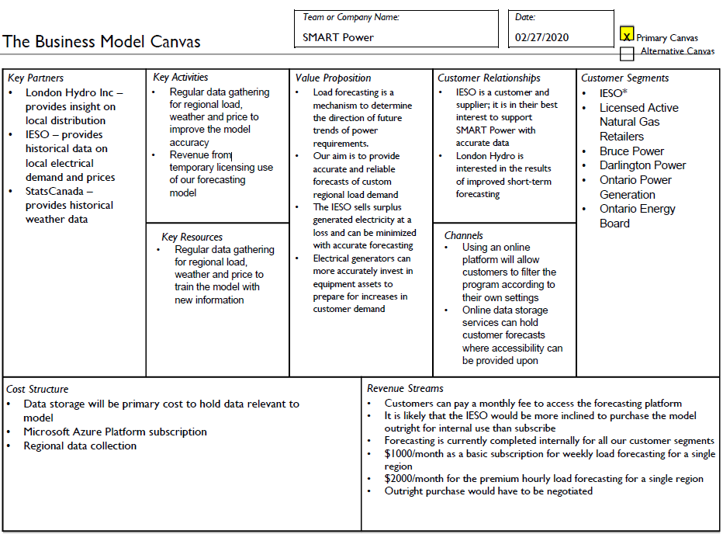
BUSINESS MODEL

Slide 7

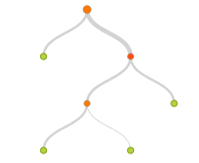


SOLUTION’S ARCHITECTURE
Some questions you may want to answer: How will you build your solution? What data will you be using? How will you obtain that data? What will be you solution’s architecture? What tools & technology will you use? Describe the technical roadmap of your solution ...
The solution can be implemented into a web-based platform, where users may access it
The model uses the shown architecture with the following sample data needed:
This information is provided hourly, for free, on the IESO and StatsCanada websites which make it a sustainable source for this solution.
The current model uses a 99 Boost Decision Tree Regression to fit the residual of the nodes that precede it, thus improving accuracy with some small risk of less coverage
The solution is built in Microsoft Azure Machine Learning Studios for concept generation and will be cloned in Python to use its open source libraries
Dataset
Eliminate Missing Values
Normalize Data
[Date, Hour, Temperature, Dew Point, Relative Humidity, Wind Speed, Sample_Region, Forecast Difference, Price]
Split Data
Train Data
Boosted Decision Tree Regression
Score Model
Evaluate

Slide 8
BENEFITS OF THE APPROACH
Some questions you may want to answer: Who will benefit from your solution? What are the direct potential benefits? Are they quantifiable? How does your solution contribute towards sustainable development?

Slide 9

TEAM PRESENTATION
SURNAME
NAME
AGE
EDUCATION
DESCRIBE YOURSELF IN A TWEET!
SURNAME
NAME
AGE
EDUCATION
DESCRIBE YOURSELF IN A TWEET!
SURNAME
NAME
AGE
EDUCATION
DESCRIBE YOURSELF IN A TWEET!
SURNAME
NAME
AGE
EDUCATION
DESCRIBE YOURSELF IN A TWEET!

